Slide 1
Interaction and input

Slide 2
Input
Old input methods
Keyboard
Navigation (primary): arrow keys, enter, page up, page down, tab
Other keys for text input
Mouse
Buttons, links, scroll, drag'n'drop, hover
New input methods
Touch
Game pad

Slide 3
Touch

Slide 4
Touch
Events on touch-sensitive screen
Capture interactions made with the user's fingers
Mobile, smartphone and tablets
History
Apple introduced their touch events API in iOS 2.0
Android has been catching up to this de-facto standard
W3C working group has come together to work on this touch events specification.

Slide 5
Touch events
Fire when the user moves his finger, whatever the context
Events
touchstart:
a finger is placed on a DOM element.
touchmove:
a finger is dragged along a DOM element.
touchend:
a finger is removed from a DOM element.

Slide 6
Other touch events
Three additional touch events, but no browsers support
touchenter
a moving finger enters a DOM element.
touchleave:
a moving finger leaves a DOM element.
touchcancel:
a touch is interrupted (implementation specific).

Slide 7
Touches
Three lists of touches:
touches
a list of all fingers currently on the screen.
targetTouches
a list of fingers on the current DOM element.
changedTouches
a list of fingers involved in the current event. For example, in a touchend event, this will be the finger that was removed.

Slide 8
Objects with touch information
identifier
a number that uniquely identifies the current finger in the touch session.
target
The DOM element that was the target of the action.
client/page/screen coordinates
where on the screen the action happened
radius coordinates and rotationAngle
describe the ellipse that approximates finger shape.

Slide 9
Interface events
Fire when a touch action leads to a certain interface reaction.
Actions
click
context menu
scroll
zoom

Slide 10
Legacy events
mouseover
mousemove
mousedown
mouseup
mouseout

Slide 11
Prevent zooming
Swipes and gestures are often associated with browser behavior, such as scrolling and zooming.
Setup your viewport so that it is not user scalable:
<meta name="viewport“
content="width=device-width, initial-scale=1.0, user-scalable=no">

Slide 12
Prevent scrolling
Prevent default “over scrolling” effect
Override default touchmove behavior
Confusing in many multi-touch applications, and can easily be disabled:
document.body.addEventListener('touchmove', function(event) {
event.preventDefault();
}, false);

Slide 13
Links – events, touch
https://developer.mozilla.org/en-US/docs/Mozilla_event_reference
http://www.quirksmode.org/mobile/tableTouch.html
http://www.html5rocks.com/en/mobile/touch/
http://www.w3.org/TR/touch-events/

Slide 14
Gamepad

Slide 15
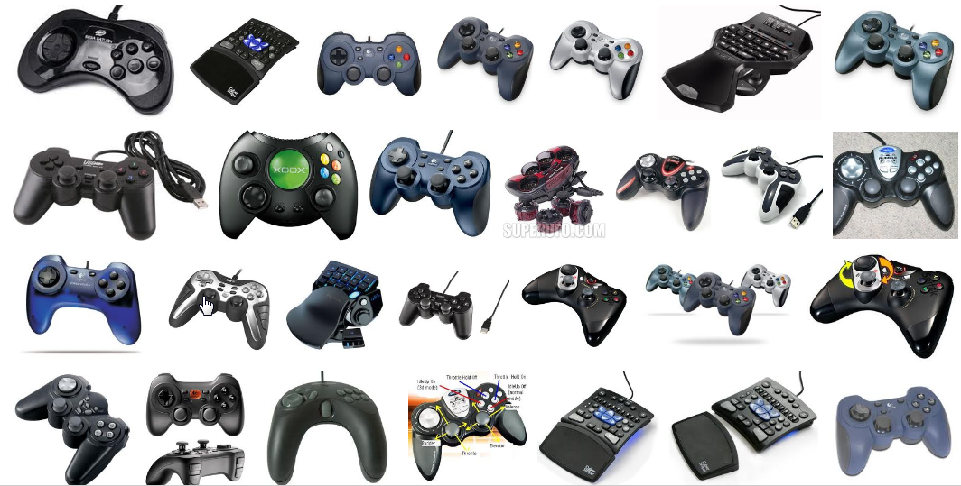
Gamepad
Interaction using a gamepad
http://www.google.com/doodles/hurdles-2012

Slide 16
What browsers support it today?
August 2012:
Chrome 21 and newer on Windows, Mac, Linux, and Chrome OS
special builds of Firefox with Gamepad API support.

Slide 17
Links - gamepad
http://www.w3.org/TR/gamepad/
http://www.html5rocks.com/en/tutorials/doodles/gamepad/

